Slide 1
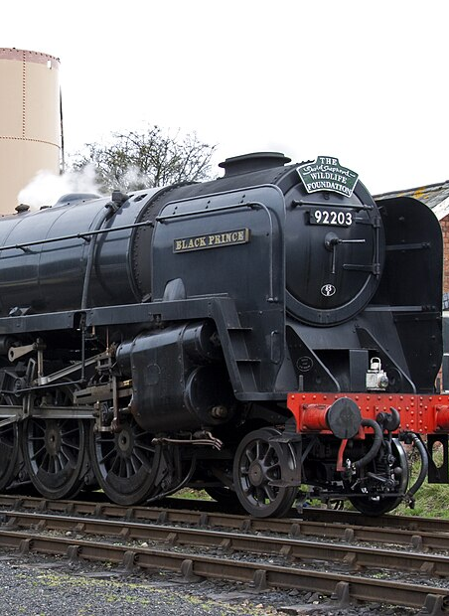
After Launch:
Late Steam, Driving and Prestige
Ideas for after the first release, for people who love steam. All of it comes later.
A real steam locomotive, shown for illustration.
Photo: Tony Hisgett, CC BY 2.0.

Slide 2
How to read this guide
AGREED
Decided.
PROPOSED
Suggested, not confirmed.
PROVISIONAL
A test number that may change.
UNDECIDED
Still an open question.
BACKGROUND
A real-world fact.
Every idea carries a tag in the top-right corner.
2

Slide 3
Electric still wins
AGREED
Speed
Throughput
Traffic density
Convenience
Steam
Electric
Shape only. Not measured.
Even with packs, electric rail stays the better railway. Steam is a choice, not an upgrade.
3

Slide 4
Steam's strength: scale
AGREED
Late steam terminal
Electric station
Late steam is about scale: big terminals, many tracks, busy yards.
4

Slide 5
For people who love steam
AGREED
Core: basic buildings
Pack: advanced buildings
Needs a pack
Advanced steam buildings come only with packs. They are for people who keep steam on purpose.
5

Slide 6
Bigger buildings
PROPOSED
Smaller terminal
Bigger terminal
Extra
platforms
Larger service
yard
Exact list: undecided (OQ22)
Bigger terminals and faster servicing could appear.
6

Slide 7
Bigger signalling
PROPOSED
Small signal box
Short reach
Large signal box
Wide reach
Bigger signal boxes and better interlocking could manage larger networks.
7

Slide 8
A line that stays
AGREED
Electronic-signal powers
Late steam must not simply copy electric rail's abilities.
8

Slide 9
Two ways to drive
AGREED
Simple: the crew handles the details
Advanced: you handle the engine
Advanced: packs only
Simple is the default. Advanced driving is optional and comes with packs.
9

Slide 10
Choosing at first use
AGREED
Simple
Advanced
Preselected
You can change this later.
Exact screens: undecided
The first time, the game asks which style you want. You can switch later.
10

Slide 11
Simple: a good crew
AGREED
Go
Fire
Steam
Valves
Crew
Simple works like a skilled crew. You say go and the crew does the rest.
11

Slide 12
Advanced: three things to manage
AGREED
1
2
3
+
Fire
Regulator
Reverser
Brake
You manage the fire, the regulator and the reverser. Braking stays too.
12

Slide 13
What you do not have to do
AGREED
Injectors
Detailed boiler water
Blower and damper
Dozens of cab valves
Procedures
No injectors and no dozens of valves. It is steam driving, not a full simulator.
13

Slide 14
Mistakes have natural results
AGREED
Wrong settings
Weaker pull
Explosions and permanent damage
Too much power
Wheels slip
Low steam pressure
Less power
Weak fire
Weaker engine
Exact rules: undecided (OQ24)
Bad driving costs speed and pulling power. It never wrecks your engine.
14

Slide 15
Skill can pay
AGREED
Speed
Prepare before the climb
Advanced
Simple
Hill
Shape only. Not measured.
How much better: undecided (OQ24)
Skilled drivers can prepare for hills and squeeze out a little more. Simple stays fine.
15

Slide 16
Liveries: history first
AGREED
Examples only.
Historical
Historical
Corporate
Custom
Engines come in historical liveries. Corporate or custom looks stay possible.
16

Slide 17
Not sold separately
AGREED
The pack you own
Historical liveries come with the pack you own. They are not sold one by one.
17

Slide 18
Picking a livery
PROPOSED
Licensing: undecided (OQ25)
You might pick liveries in the game's own customiser. That is not checked yet.
18

Slide 19
Prestige engines
AGREED
Extremely expensive
Not better at hauling
BACKGROUND Like the game's golden trophies
Prestige engines are trophies for display. They are not better at hauling.
19

Slide 20
Famous, named engines
AGREED
1
Fixed name
Fixed number
One per world
Which engines: undecided (OQ25)
A prestige engine is one real, famous machine. Its name and number never change.
20

Slide 21
Prestige in the core game
AGREED
Fixed name and number
Normal engine
Prestige engine
Even the core game could have a prestige engine: one special member of a core class.
21

Slide 22
Showpiece coaches
PROPOSED
Display only
Which coaches: undecided (OQ25)
Historic coaches might join a prestige engine for show. There is still no passenger economy.
22

Slide 23
Where this stands
PROVISIONAL
Advanced buildings:
an idea
Advanced driving:
an idea
Liveries:
an idea
Prestige engines:
an idea
PROVISIONAL Plans can change.
Late steam, advanced driving and prestige are ideas for after launch.
23

Slide 24
Still undecided
UNDECIDED
UNDECIDED
UNDECIDED
UNDECIDED
UNDECIDED
Which advanced buildings? (OQ22)
Balance against electric (OQ22)
Driving formulas (OQ24)
Size of the Advanced bonus (OQ24)
UNDECIDED
UNDECIDED
UNDECIDED
UNDECIDED
Livery integration (OQ25)
Which prestige engines? (OQ25)
Prestige prices (OQ25)
Names and licences (OQ25)
These questions are open. Nothing here has been chosen yet.
24

Slide 25
Image credits
Slot | Slide | Author | Licence | Source link
P12 | 1 | Tony Hisgett | CC BY 2.0 | Commons
CC BY-SA photos are shown unmodified except for resizing.
The photograph shows a real steam locomotive. It is not a model from the mod.
Photographs come from Wikimedia Commons under Creative Commons licences.
25

